Slide 1
Hopfield Neural Networks

Slide 2
Dataset
EEG & Student Comprehension Study:
Conducted during Covid-19 lockdown to explore whether brain activity can detect student understanding of online lectures.
Participants:
Middle school students
High school students
Undergraduate students
Method:
Preassessed students' knowledge base
Selected videos each student would and wouldn't understand
Recorded EEG/brain wave data during viewing
Labelled comprehension: 1 = Understood, 0 = Did not understand
Data Collected:
EEG recordings
subject details
video details
Goal:
Predict student comprehension from brain activity

Slide 3
Research Question:
Can we classify/label the subject_understood flag using Hopfield Neural Networks as outlined in (Ramsauer et al., 2021)
For the purposes of this neural data science project we will mainly concern ourselves with the EEG_data.csv dataset

Slide 5
What is a Hopfield Network
Technically this is outside of the 10 year time window for papers
Modeled neural networks as physical systems with an energy function. Neurons are binary (on/off); the network evolves to minimize energy, settling into stored "memories“.
Associative memory: recover a full pattern from partial/noisy input
Hebbian learning: neurons that fire together, wire together
Attractors: the patterns the network is attempting to retrieve are energy valleys the network "falls into“
Bridged neuroscience, physics & CS helped revive the neural network field. Foundation for modern attention mechanisms. Hopfield won the Nobel Prize in Physics (2024).

Slide 6
What is a Modern Hopfield Network
The actual paper we are basing the method on improves on John Hopfields methods by using real value vectors instead of binary neurons.
The update rule

Slide 7
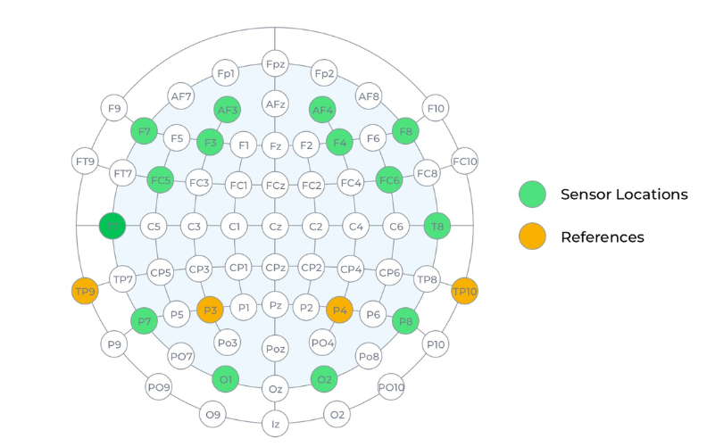
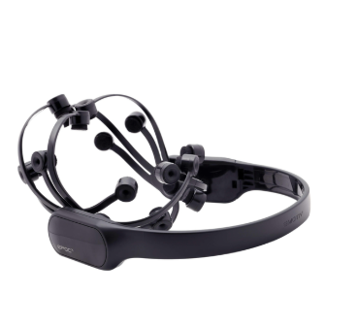
Hardware
The EEG recording was done using a Emotiv Epoch IV
14 channels: AF3, F7, F3, FC5, T7, P7, O1, O2, P8, T8, FC6, F4, F8, AF4
Sampling Rate: 128 SPS / 256 SPS (2048 Hz internal)
Bandwidth: 0.2 - 45Hz digital notch filters at 50Hz and 60Hz
EEG Resolution: 14 bits 1 LSB = 0.51μV

Slide 8
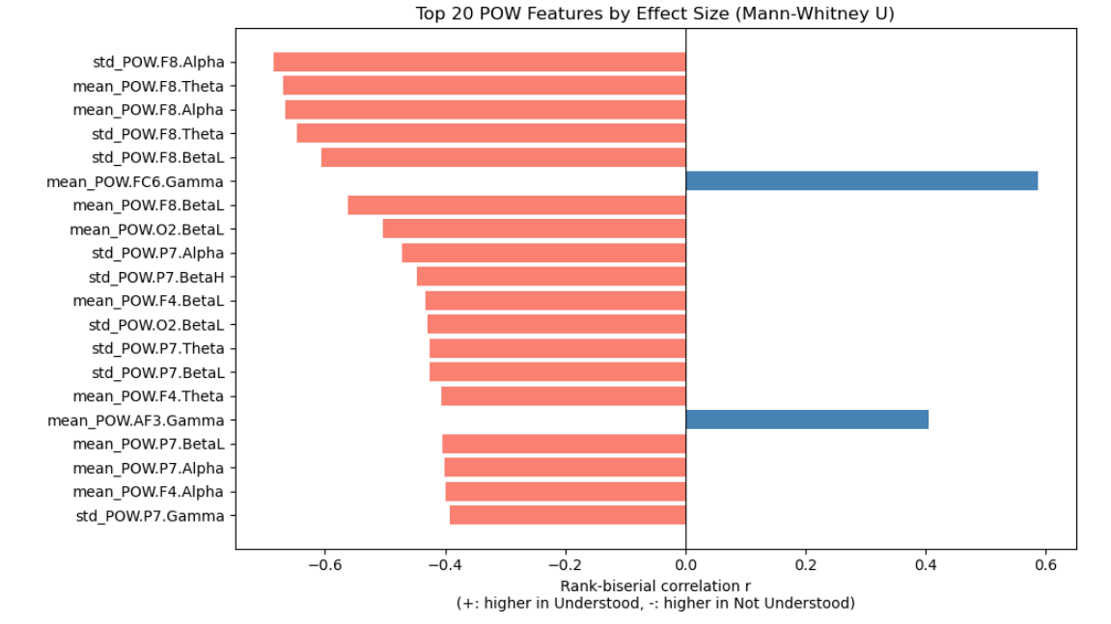
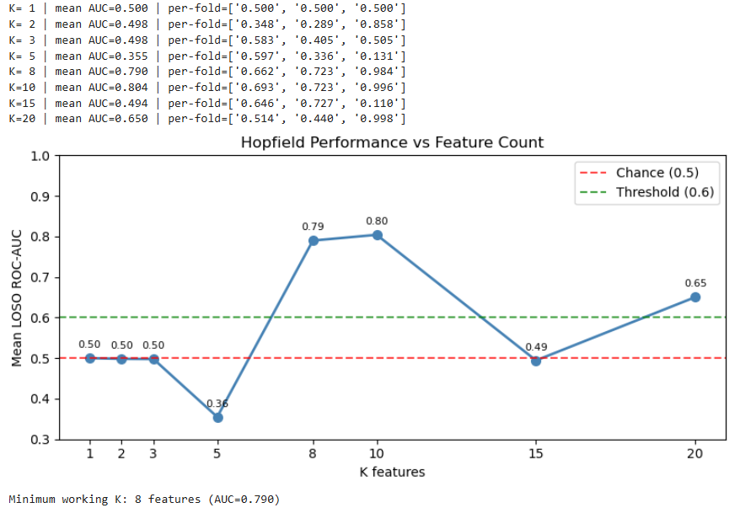
Results (Graphs)

Slide 9
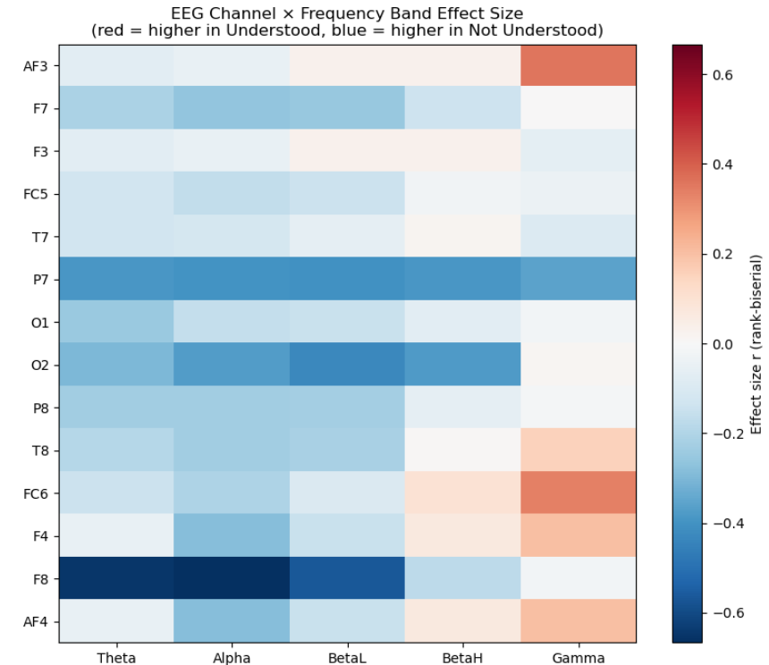
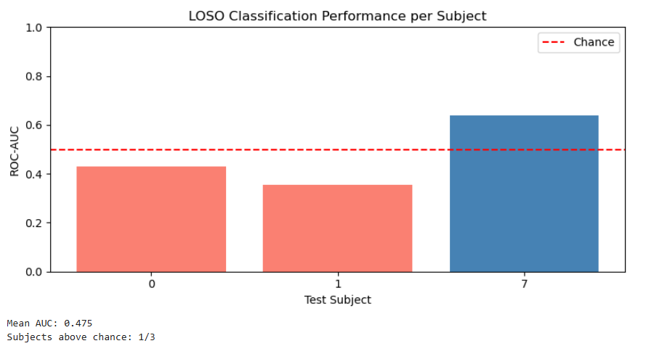
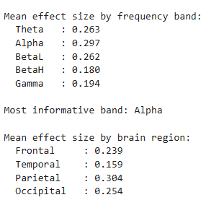
Results (Graph)
Interpretation
Interpretation

Slide 10
Conclusion

Slide 11
Sources
Emotiv Epoc X - 14-Channel Research-Grade EEG Headset Device
Coverage | EPOC X User Manual
Technical specifications | EPOC X User Manual
Hopfield Networks is All You Need
EEG data / Distance learning
Neural networks and physical systems with emergent collective computational abilities.

